Slide 1
Dynamic Programming
0/1 Knapsack Problem

Slide 2
Contents
What is dynamic Programming
History of dynamic programming
Remember the Fibonacci Series? : A basic intuition
Dynamic Programming and Optimization Problems
0/1 – Knapsack Problem
Prelude to part Dynamic Programming part 2

Slide 3
What is Dynamic Programming?
Dynamic Programming is a technique in computer programming that helps to efficiently solve a class of problems that have
overlapping sub problems
optimal substructure property.
We will see what these properties mean soon.

Slide 4
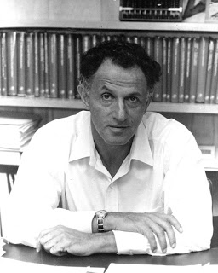
History of Dynamic Programming
Bellman was working for RAND corporation which was employed by the Air Force.
He was working on creating a multi stage decision process.
For this he needed funding.
He needed find from the then Secretary of Defense, who hated the word ‘research.’
To hide the fact that he was conducting mathematics based research – he chose the name Dynamic Programming.
Richard Bellman

Slide 5
Remember the Fibonacci Series?
A basic intuition about Dynamic Programming

Slide 6
Fibonacci Series
f(5)
f(4)
f(3)
f(3)
f(2)
f(2)
f(1)
f(2)
f(1)
f(1)
f(0)
f(1)
f(0)
f(1)
f(0)

Slide 7
Fibonacci Series with an extra table
F | value
5 | -1
4 | -1
3 | -1
2 | -1
1 | 1
0 | 1
f(5)
f(4)
f(3)
f(3)
f(2)
f(2)
f(1)
f(2)
f(1)
f(1)
f(0)
f(1)
f(0)
f(1)
f(0)
Optimal Substructure Property?
Overlapping Sub problems

Slide 8
Outcomes obtained so far
Till now we seem to have understood the following:
We know about the overlapping sub problems property .
We know about the optimal substructure property.
We know that dynamic programming requires the use of a table (we may use an array or other DS to store this), to avoid calling recursive functions

Slide 9
Dynamic Programming and Optimization Problems
0/1 – Knapsack Problem

Slide 10
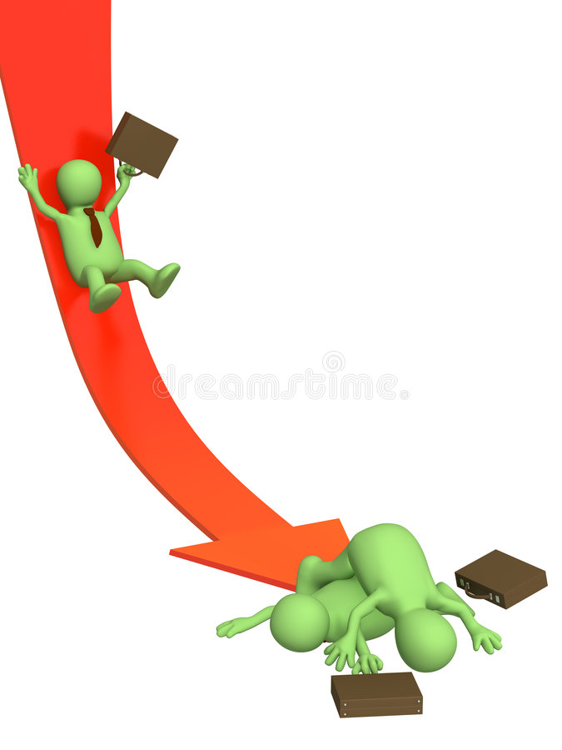

Optimization Problems
For optimization problems 3 popular strategies are:
Greedy Method
Dynamic Programming Method
Branch and Bound Method

Slide 11
What is an optimization problem?
You are studying Dynamic Programming. What is the minimum time you would require for finishing the chapter? (and how?)
You are given a set of Dynamic Programming problems. What is the maximum score you can obtain from the test? (and how?)
You are given an infinite number of coins with values 1, 2 and 5 taka. What is the minimum number of coins you can use to have 11 taka? (and how?)

Slide 12
The 0/1 Knapsack Problem
Given a set of items, each with a weight and a value, determine the number of each item to include in a collection so that the total weight is less than or equal to a given limit and the total value is as large as possible.
Huge sentence ! Let’s avoid reading this for now.

Slide 13


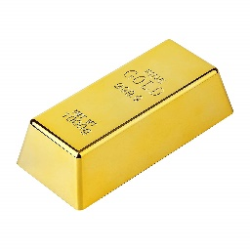



0/1 knapsack problem
$ 3
$ 4
$ 5
$ 6
2 Kg
3 Kg
4 Kg
5 Kg
5 Kg

Slide 14
0/1 knapsack problem
$ 3
$ 4
$ 5
$ 6
2 Kg
3 Kg
4 Kg
5 Kg
5 Kg

Slide 15
0/1 knapsack problem
$ 3
$ 4
$ 5
$ 6
2 Kg
3 Kg
4 Kg
5 Kg
5 Kg

Slide 16
0/1 knapsack problem
$ 3
$ 4
$ 5
$ 6
2 Kg
3 Kg
4 Kg
5 Kg
5 Kg

Slide 17
0/1 knapsack problem
$ 3
$ 4
$ 5
$ 6
2 Kg
3 Kg
4 Kg
5 Kg
5 Kg

Slide 18
0/1 knapsack problem
$ 3
$ 4
$ 5
$ 6
2 Kg
3 Kg
4 Kg
5 Kg
Which items would you steal?
Don’t be GREEDY
5 Kg

Slide 19




Problem Formulation
What’s the maximum amount can the thief with a bag with 5Kg of capacity steal from the 4 items?
K (5 kg, 4 items)
K ( w, n )
$ 4
$ 5
$ 6
$ 3
2 Kg
3 Kg
4 Kg
5 Kg
5 Kg
Observe where the thief is standing

Slide 20
Problem Formulation
What’s the maximum amount can the thief with a bag with 5Kg of capacity steal from the 4 items?
K (2 kg, 2 items)
K ( w, n )
$ 4
$ 5
$ 6
$ 3
2 Kg
3 Kg
4 Kg
5 Kg
2 Kg
Observe where the thief is standing

Slide 21
Yes, we can solve it recursively.
$ 4
$ 5
$ 6
$ 3
k(5,4)
2 Kg
3 Kg
4 Kg
5 Kg
0
6
k(5,3)
k(0,3)
5
0
k(5,2)
k(1,2)
0
4
0
k(5,1)
k(2,1)
k(1,1)
4
0
3
0
3
0
3
k(5,0)
k(3,0)
k(2,0)
k(0,0)
k(1,0)
k(1-2,0)
k(1-3,1)
0
0
0
0
0

Slide 22
Yes, we can solve it recursively.
$ 4
$ 5
$ 6
7
$ 3
k(5,4)
2 Kg
3 Kg
4 Kg
5 Kg
0
7
0
6
k(5,3)
k(0,3)
Problems with this approach:
1. Recursion takes a lot of time (does the same work again and again due to overlapping sub problems property).
2. No table, hence no way to trace the sequence of actions.
3. Overlapping subproblems?
5
0
7
0
k(5,2)
k(1,2)
3
0
4
3
0
0
k(5,1)
k(2,1)
k(1,1)
0
0
3
3
0
0
3
0
0
0
k(5,0)
k(3,0)
k(2,0)
k(0,0)
k(1,0)
0
0
0
0
0

Slide 23
Let us formulate this problem using dynamic programming
The recursive equation:
K( w, i ) = max { k( w , i-1 ), prices[ i ]+k( w - weights[ i ] , i-1) }
Here:
w= free space inside my bag
i = the number of items left to steal/ the item I am about to steal
prices = array containing the prices of the items we are thinking about stealing
weights = array containing the weights of the items we are thinking about stealing
There are two approaches for solving this issue using dynamic programming
Top Down (memorization) – starts from the root
Bottom Up – starts from the leaves

Slide 24
Let us formulate this problem using dynamic programming
The recursive equation:
K( w, i ) = max { k( w , i-1 ), prices[ i ]+k( w - weights[ i ] , i-1) }
Here:
w= free space inside my bag
i = the number of items left to steal/ the item I am about to steal
prices = array containing the prices of the items we are thinking about stealing
weights = array containing the weights of the items we are thinking about stealing
There are two approaches for solving this issue using dynamic programming
Top Down (memorization) – starts from the root
Bottom Up – starts from the leaves
Profit if item not taken
Profit if the ith item is taken

Slide 25
Top Down Approach
Using memoization
At first write the recursive code
Then include the memoization code

Slide 26
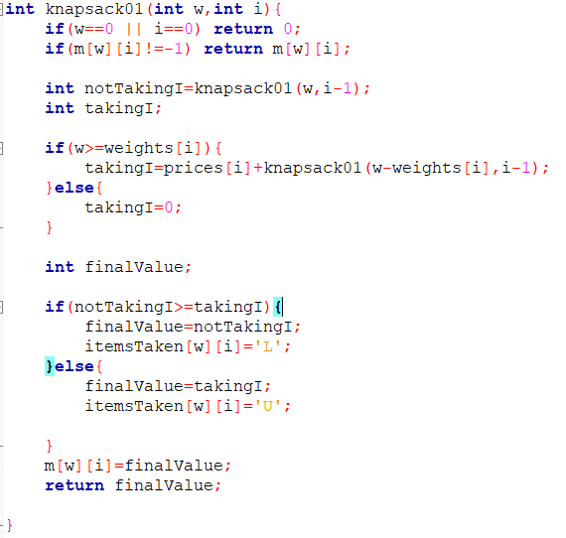
Top Down Approach
Using memoization
At first write the recursive code
Then include the memoization code

Slide 27
Top Down Approach
Using memoization
At first write the recursive code
Then include the memoization code
(see the animation in next slide first If needed)
Note:
For memoization you must
Prepare a 2d array for the table.
m[W+1][N+1]

Slide 28
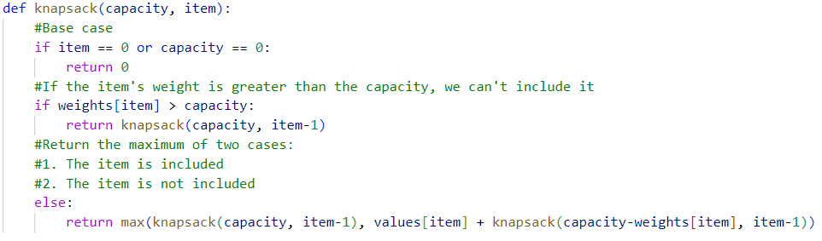
Top Down Approach (For BSDS)
Using memoization
At first write the recursive code
Then include the memoization code

Slide 29
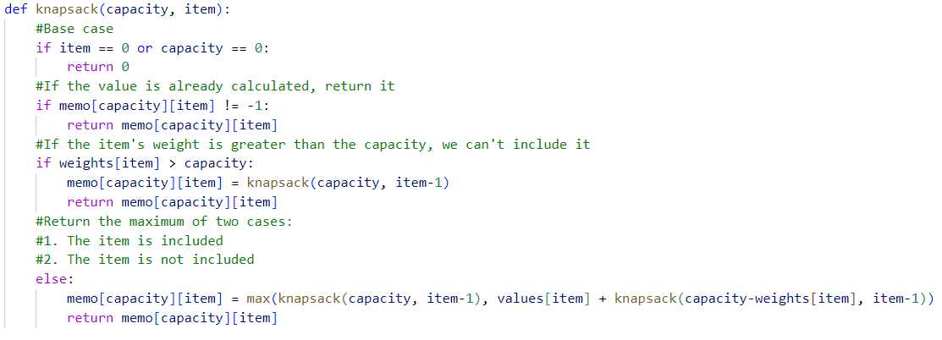
Top Down Approach (For BSDS)
Using memoization
At first write the recursive code
Then include the memoization code
Note:
For memoization you must
Prepare a 2d array for the table.
m[W+1][N+1]

Slide 30
Memoization (Behind The scenes)
prices | 12 | 10 | 20 | 15
weights | 2 | 1 | 3 | 2
You know how memoization works.
32
n
0
1
2
3
4
K(5,3)
w
-1
-1
-1
-1
-1
0
1
-1
0
-1
-1
-1
2
-1
12
12
-1
-1
3
-1
12
22
22
-1
4
-1
12
-1
-1
-1
5
-1
12
22
32
37

Slide 31
The Top Down Approach
prices | 12 | 10 | 20 | 15
weights | 2 | 1 | 3 | 2
You know how memoization works.
12
22
22
n
K(4,2)
0
1
2
3
4
w
0
10
-1
-1
-1
-1
-1
12
12
0
K(4,1)
K(3,1)
-1
0
-1
-1
-1
1
12
12
0
0
2
-1
12
12
-1
-1
K(3,0)
K(2,0)
0
0
-1
12
3
-1
22
22
-1
-1
12
-1
-1
-1
4
22
5
-1
12
22
32
37

Slide 32
The Top Down Approach
Memoization requires the recursive calls.
There is no gurantee that a value will be there in the table
For example K(5,4) does not mean that there is a value in m[5][4]
However, the bottom up approach creates all the possible values (for the given scenario)

Slide 33
Bottom Up Approach
prices | 12 | 10 | 20 | 15
weights | 2 | 1 | 3 | 2
Basically we will fill up all the values of the table.
n
0
1
2
3
4
w
0
0
0
0
0
0
1
0
0
10
10
10
2
0
12
12
12
15
3
0
12
22
22
25
4
0
12
22
30
30
5
0
12
22
32
37

Slide 34
Bottom Up Approach
Let us look at the equation for this:
K( w, i ) = max { k( w , i-1 ), prices[ i ]+k( w - weights[ i ] , i-1) }
If(w>weights[i])

Slide 35
Bottom Up Approach
prices | 12 | 10 | 20 | 15
weights | 2 | 1 | 3 | 2
Let us look at the equation for this:
K( w, i ) =
max {0+ k( w , i-1 ), prices[ i ]+k( w - weights[ i ] , i-1) }
n
w
0
1
2
3
4
0
1
k(w-weights[i] ,i-1)
n
2
w
0
1
2
3
4
0
3
1
K(w,i)
2
4
k(w,i-1)
3
4
5
5

Slide 36
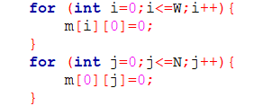
Bottom Up Approach
prices | 12 | 10 | 20 | 15
weights | 2 | 1 | 3 | 2
We will at first fill up all the base cases
n
0
1
2
3
4
w
0
0
0
0
0
0
1
0
2
0
3
0
4
0
5
0

Slide 37
Bottom Up Approach
prices | 12 | 10 | 20 | 15
weights | 2 | 1 | 3 | 2
Then we will traverse and fill up the cells of the table.
Each cell will be based on the given formula
m[w][i] = max { m[w][i-1], prices[ i ]+ k [w - weights[ i ]] , [i-1] }
Of course we have to check if w-weights[i]>=0
n
0
1
2
3
4
W(capacity)
0
0
0
0
0
0
1
0
0
10
10
10
2
0
12
12
12
15
3
0
12
22
22
25
4
0
12
22
30
30
5
0
12
22
32
37

Slide 38
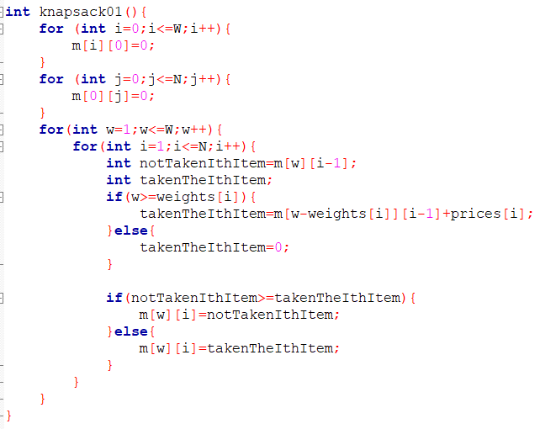
Bottom Up Approach
prices | 12 | 10 | 20 | 15
weights | 2 | 1 | 3 | 2
n
0
1
2
3
4
w
0
0
0
0
0
0
0
0
10
10
10
1
0
12
12
12
15
2
3
0
12
22
22
25
4
0
12
22
30
30
5
0
12
22
32
37

Slide 39
Tracking which items were taken
Seeing the data in the memo
Keeping an additional table

Slide 40
Tracking which items were taken
Seeing the data in the memo (not required)
Keeping an additional table

Slide 41
Tracking which items were taken
prices | 12 | 10 | 20 | 15
weights | 2 | 1 | 3 | 2
Seeing the data in the memo
n
0
1
2
3
4
w
k(5,4)
0
0
0
0
0
0
0
15
1
0
0
10
10
10
k(5,3)
k(3,3)
2
0
12
12
12
15
3
0
12
22
22
25
Item 4 has been taken
0
12
22
30
30
4
5
0
12
22
32
37

Slide 42
Tracking which items were taken
prices | 12 | 10 | 20 | 15
weights | 2 | 1 | 3 | 2
Seeing the data in the memo
n
0
1
2
3
4
w
k(3,3)
0
0
0
0
0
0
0
20
1
0
0
10
10
10
k(3,2)
k(3-3,2)
2
0
12
12
12
15
3
0
12
22
22
25
Item 4 has been taken
0
12
22
30
30
4
Item 3 hasn’t been taken
5
0
12
22
32
37

Slide 43
Tracking which items were taken
prices | 12 | 10 | 20 | 15
weights | 2 | 1 | 3 | 2
Seeing the data in the memo
n
0
1
2
3
4
w
k(3,2)
0
0
0
0
0
0
0
10
1
0
0
10
10
10
k(3,1)
k(3-1,1)
2
0
12
12
12
15
3
0
12
22
22
25
Item 4 has been taken
0
12
22
30
30
4
Item 3 hasn’t been taken
Item 2 has been taken
0
12
22
32
37
5

Slide 44
Tracking which items were taken
prices | 12 | 10 | 20 | 15
weights | 2 | 1 | 3 | 2
Seeing the data in the memo
n
0
1
2
3
4
w
k(2,1)
0
0
0
0
0
0
0
12
1
0
0
10
10
10
k(2,0)
k(2-2,0)
2
0
12
12
12
15
3
0
12
22
22
25
Item 4 has been taken
0
12
22
30
30
4
Item 3 hasn’t been taken
Item 2 has been taken
0
12
22
32
37
5
Item 1 has been taken

Slide 45
Tracking which items were taken
prices | 12 | 10 | 20 | 15
weights | 2 | 1 | 3 | 2
Seeing the data in the memo
This is the base case
n
0
1
2
3
4
w
0
0
0
0
0
0
1
0
0
10
10
10
2
0
12
12
12
15
3
0
12
22
22
25
Item 4 has been taken
0
12
22
30
30
4
Item 3 hasn’t been taken
Item 2 has been taken
0
12
22
32
37
5
Item 1 has been taken

Slide 46
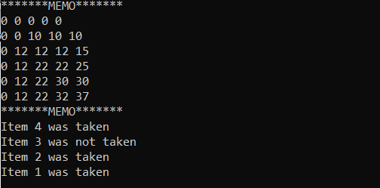
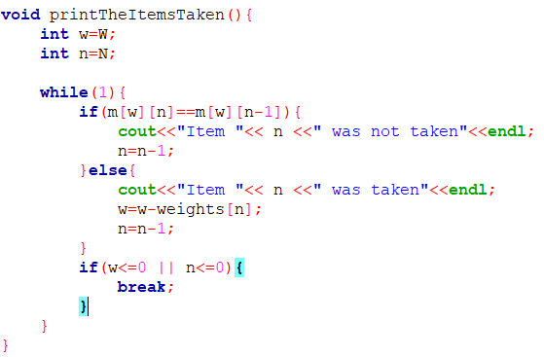

Slide 47
Tracking which items were taken
Seeing the data in the memo (Not Required)
Keeping an additional table

Slide 48
Keeping an additional table
prices | 12 | 10 | 20 | 15
weights | 2 | 1 | 3 | 2
n
0
1
2
3
4
n
0
1
2
3
4
w
w
0
0
0
0
0
-
-
-
-
-
0
0
1
0
0
10
10
10
1
-
N
T
N
N
0
12
12
12
15
2
-
T
N
N
T
2
3
0
12
22
22
25
3
-
T
T
N
T
4
0
12
22
30
30
4
-
T
T
T
N
5
0
12
22
32
37
5
-
T
T
T
T

Slide 49
Tracking which items were taken
prices | 12 | 10 | 20 | 15
weights | 2 | 1 | 3 | 2
n
0
1
2
3
4
w
-
-
-
-
-
0
1
-
N
T
N
N
2
-
T
N
N
T
3
-
T
T
N
T
4
-
T
T
T
N
5
-
T
T
T
T

Slide 50
Tracking which items were taken
prices | 12 | 10 | 20 | 15
weights | 2 | 1 | 3 | 2
n
0
1
2
3
4
w
-
-
-
-
-
0
1
-
N
T
N
N
2
-
T
N
N
T
3
-
T
T
N
T
4
-
T
T
T
N
5
-
T
T
T
T

Slide 51
Tracking which items were taken
prices | 12 | 10 | 20 | 15
weights | 2 | 1 | 3 | 2
n
0
1
2
3
4
w
-
-
-
-
-
0
1
-
N
T
N
N
2
-
T
N
N
T
3
-
T
T
N
T
4
-
T
T
T
N
5
-
T
T
T
T

Slide 52
Tracking which items were taken
prices | 12 | 10 | 20 | 15
weights | 2 | 1 | 3 | 2
n
0
1
2
3
4
w
-
-
-
-
-
0
1
-
N
T
N
N
2
-
T
N
N
T
3
-
T
T
N
T
4
-
T
T
T
N
5
-
T
T
T
T

Slide 53
Tracking which items were taken
prices | 12 | 10 | 20 | 15
weights | 2 | 1 | 3 | 2
n
0
1
2
3
4
w
-
-
-
-
-
0
1
-
N
T
N
N
2
-
T
N
N
T
3
-
T
T
N
T
4
-
T
T
T
N
5
-
T
T
T
T

Slide 54
Tracking which items were taken
prices | 12 | 10 | 20 | 15
weights | 2 | 1 | 3 | 2
n
0
1
2
3
4
w
-
-
-
-
-
0
1
-
N
T
N
N
Do it yourself 1:
Write a pseudocode for
printing from this table
-
T
N
N
T
2
3
-
T
T
N
T
4
-
T
T
T
N
5
-
T
T
T
T

Slide 55
Time Complexity
Naive Recursive Solution:
O(2^n)
Bottom up approach:
O(N*W)
Memoization
O (N*W)

